Slide 1
First Update of Project
By We Don’t Byte: Tim Lynch, Evan Nilson, Amber Wise

Slide 2
Patterns Used:
Template
Hero/Monster hierarchy (both inherit from an ‘Entity’ class)
Items classification (potions, weapons, equipment all fall under item)
Decorator
Used in wrapping effects on weapons (burning, freezing, etc.)
Factory
Used in creating monsters, heroes, and weapons when populating the map
MVC
GUI somewhat follows Model-View Controller

Slide 3
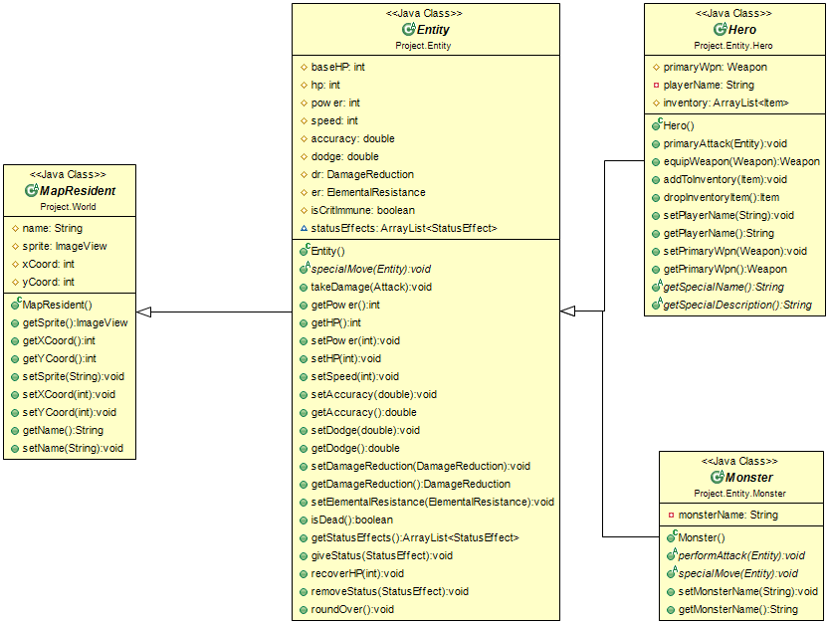
Patterns Used: Template

Slide 4
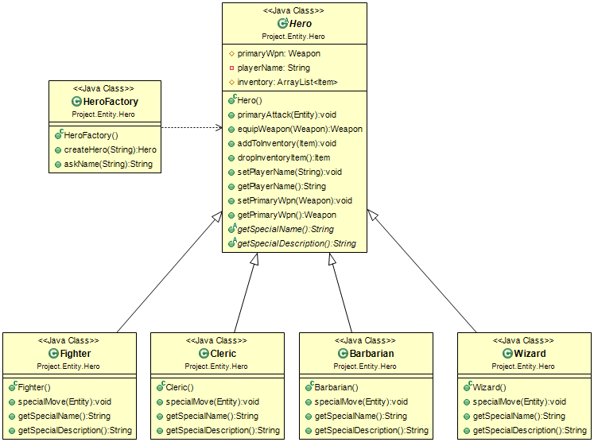
Patterns Used: Template and Factory

Slide 5
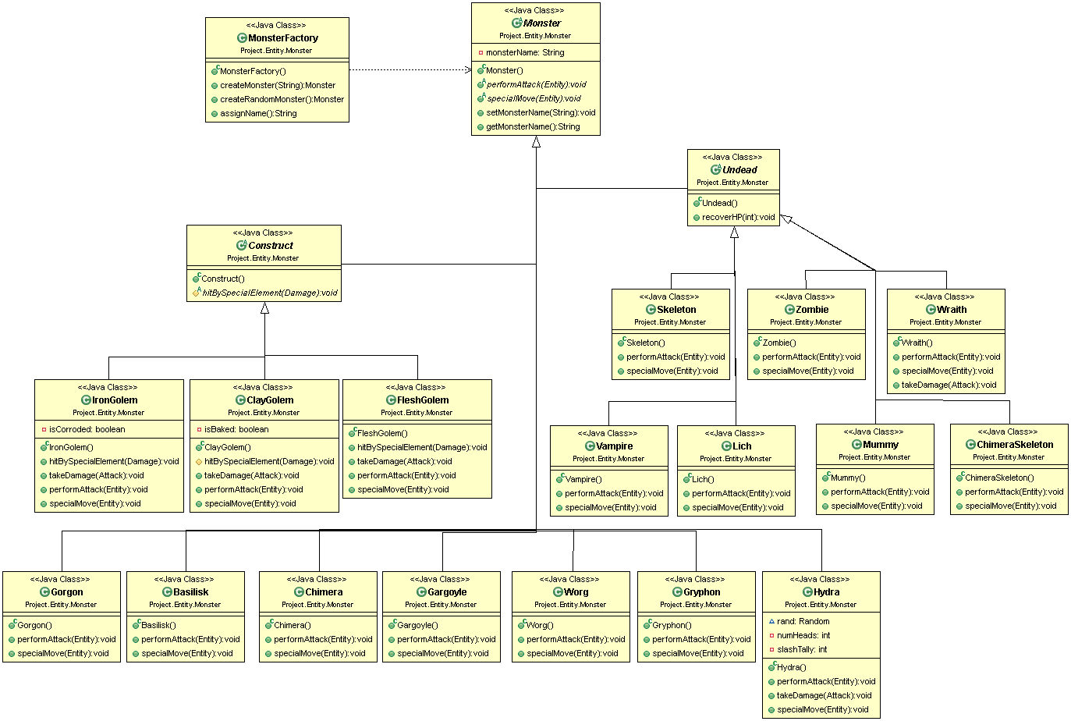
Patterns Used: Template and Factory

Slide 6
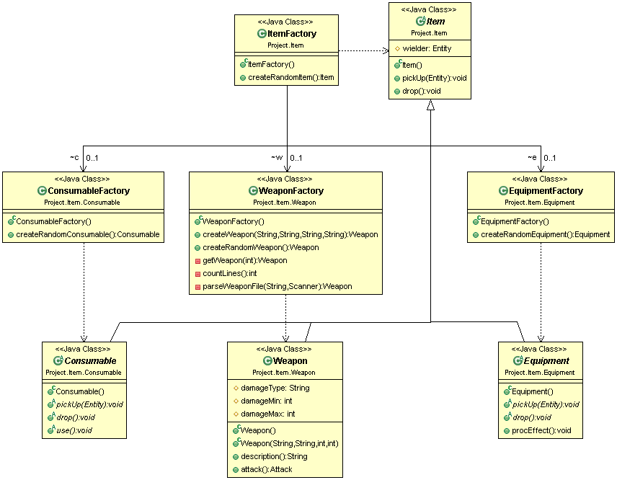
Patterns Used: Template and Factory

Slide 7
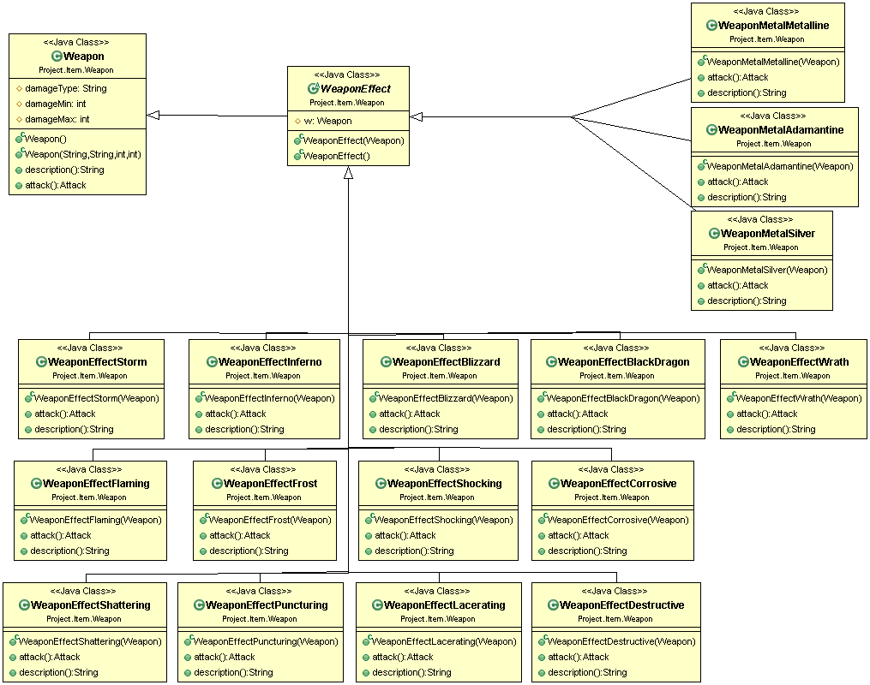
Patterns Used: Decorator

